Slide 1

An online contest judging and interactive rubric platform
Senior Design Spring 2020
Notes:
Jordyn: Hello everyone! My name is Jordyn Dent and we are the e-Valuate team! For those of you who don’t yet know what e-Valuate is, e-Valuate is an online contest judging and interactive rubric platform that we have developed for our 2019-2020 senior design project. We have worked hard on this project all year and I am super excited to present it today.
Transition (Jordyn): So before we jump into the project’s background and our solution, let me first introduce our team.

Slide 2
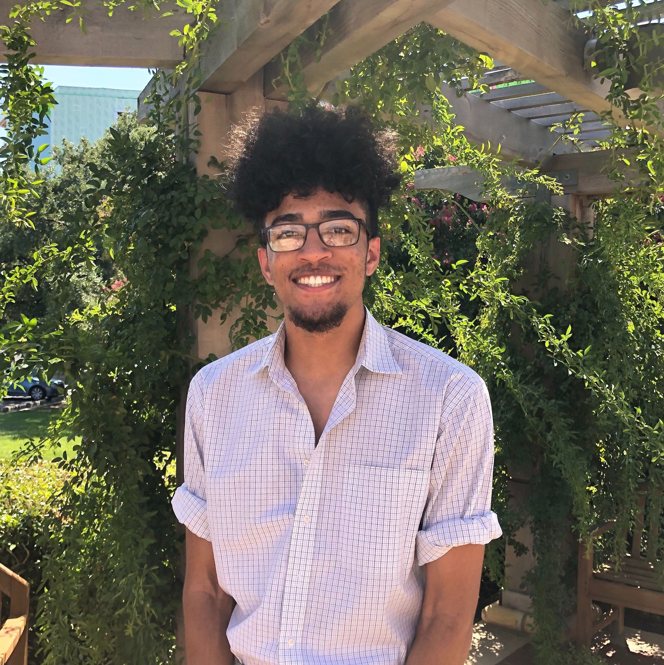
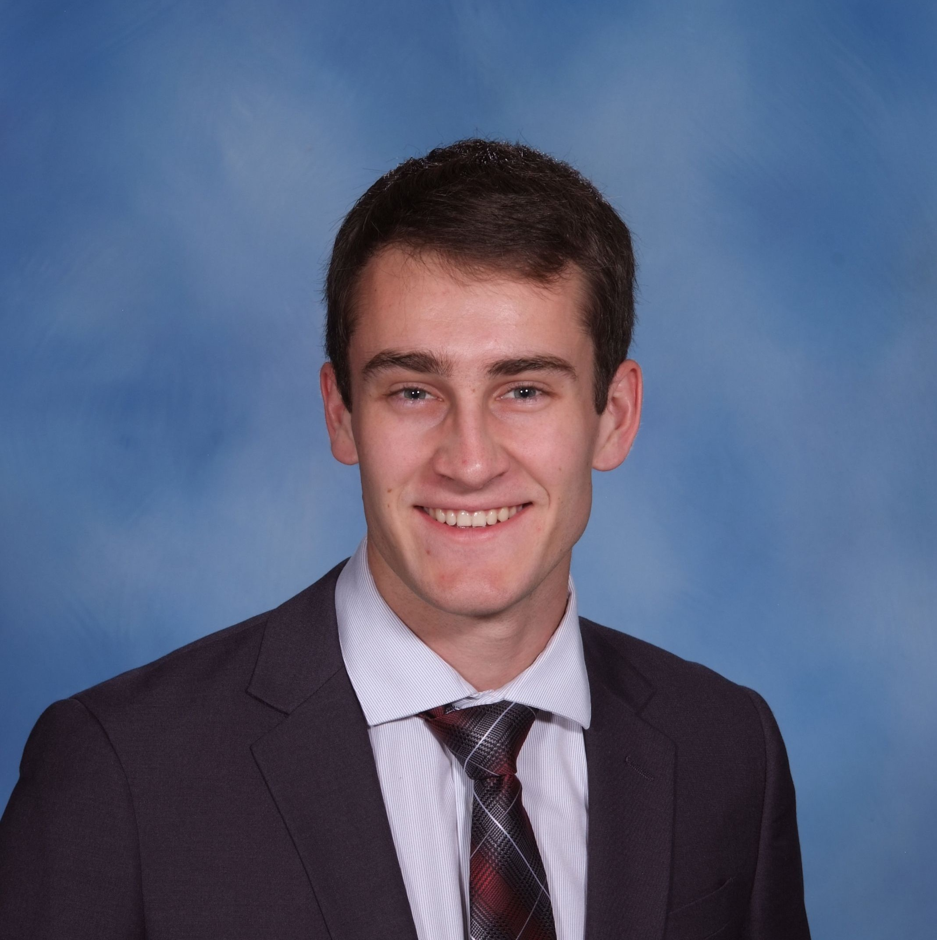
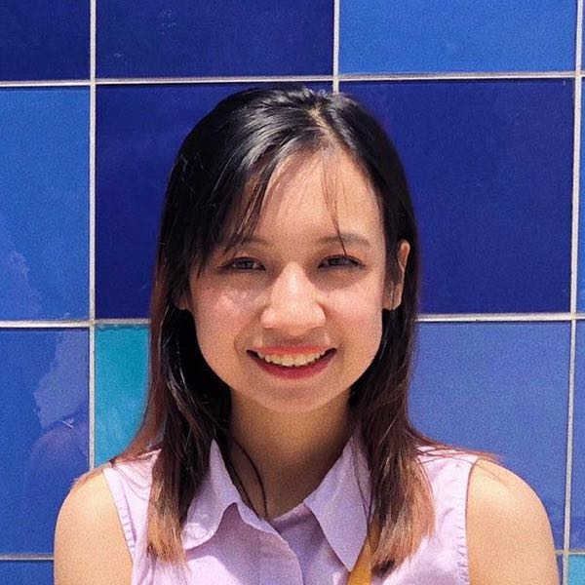
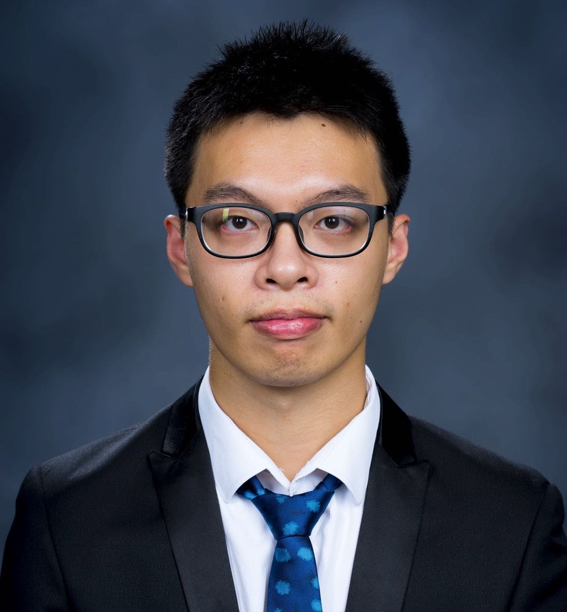
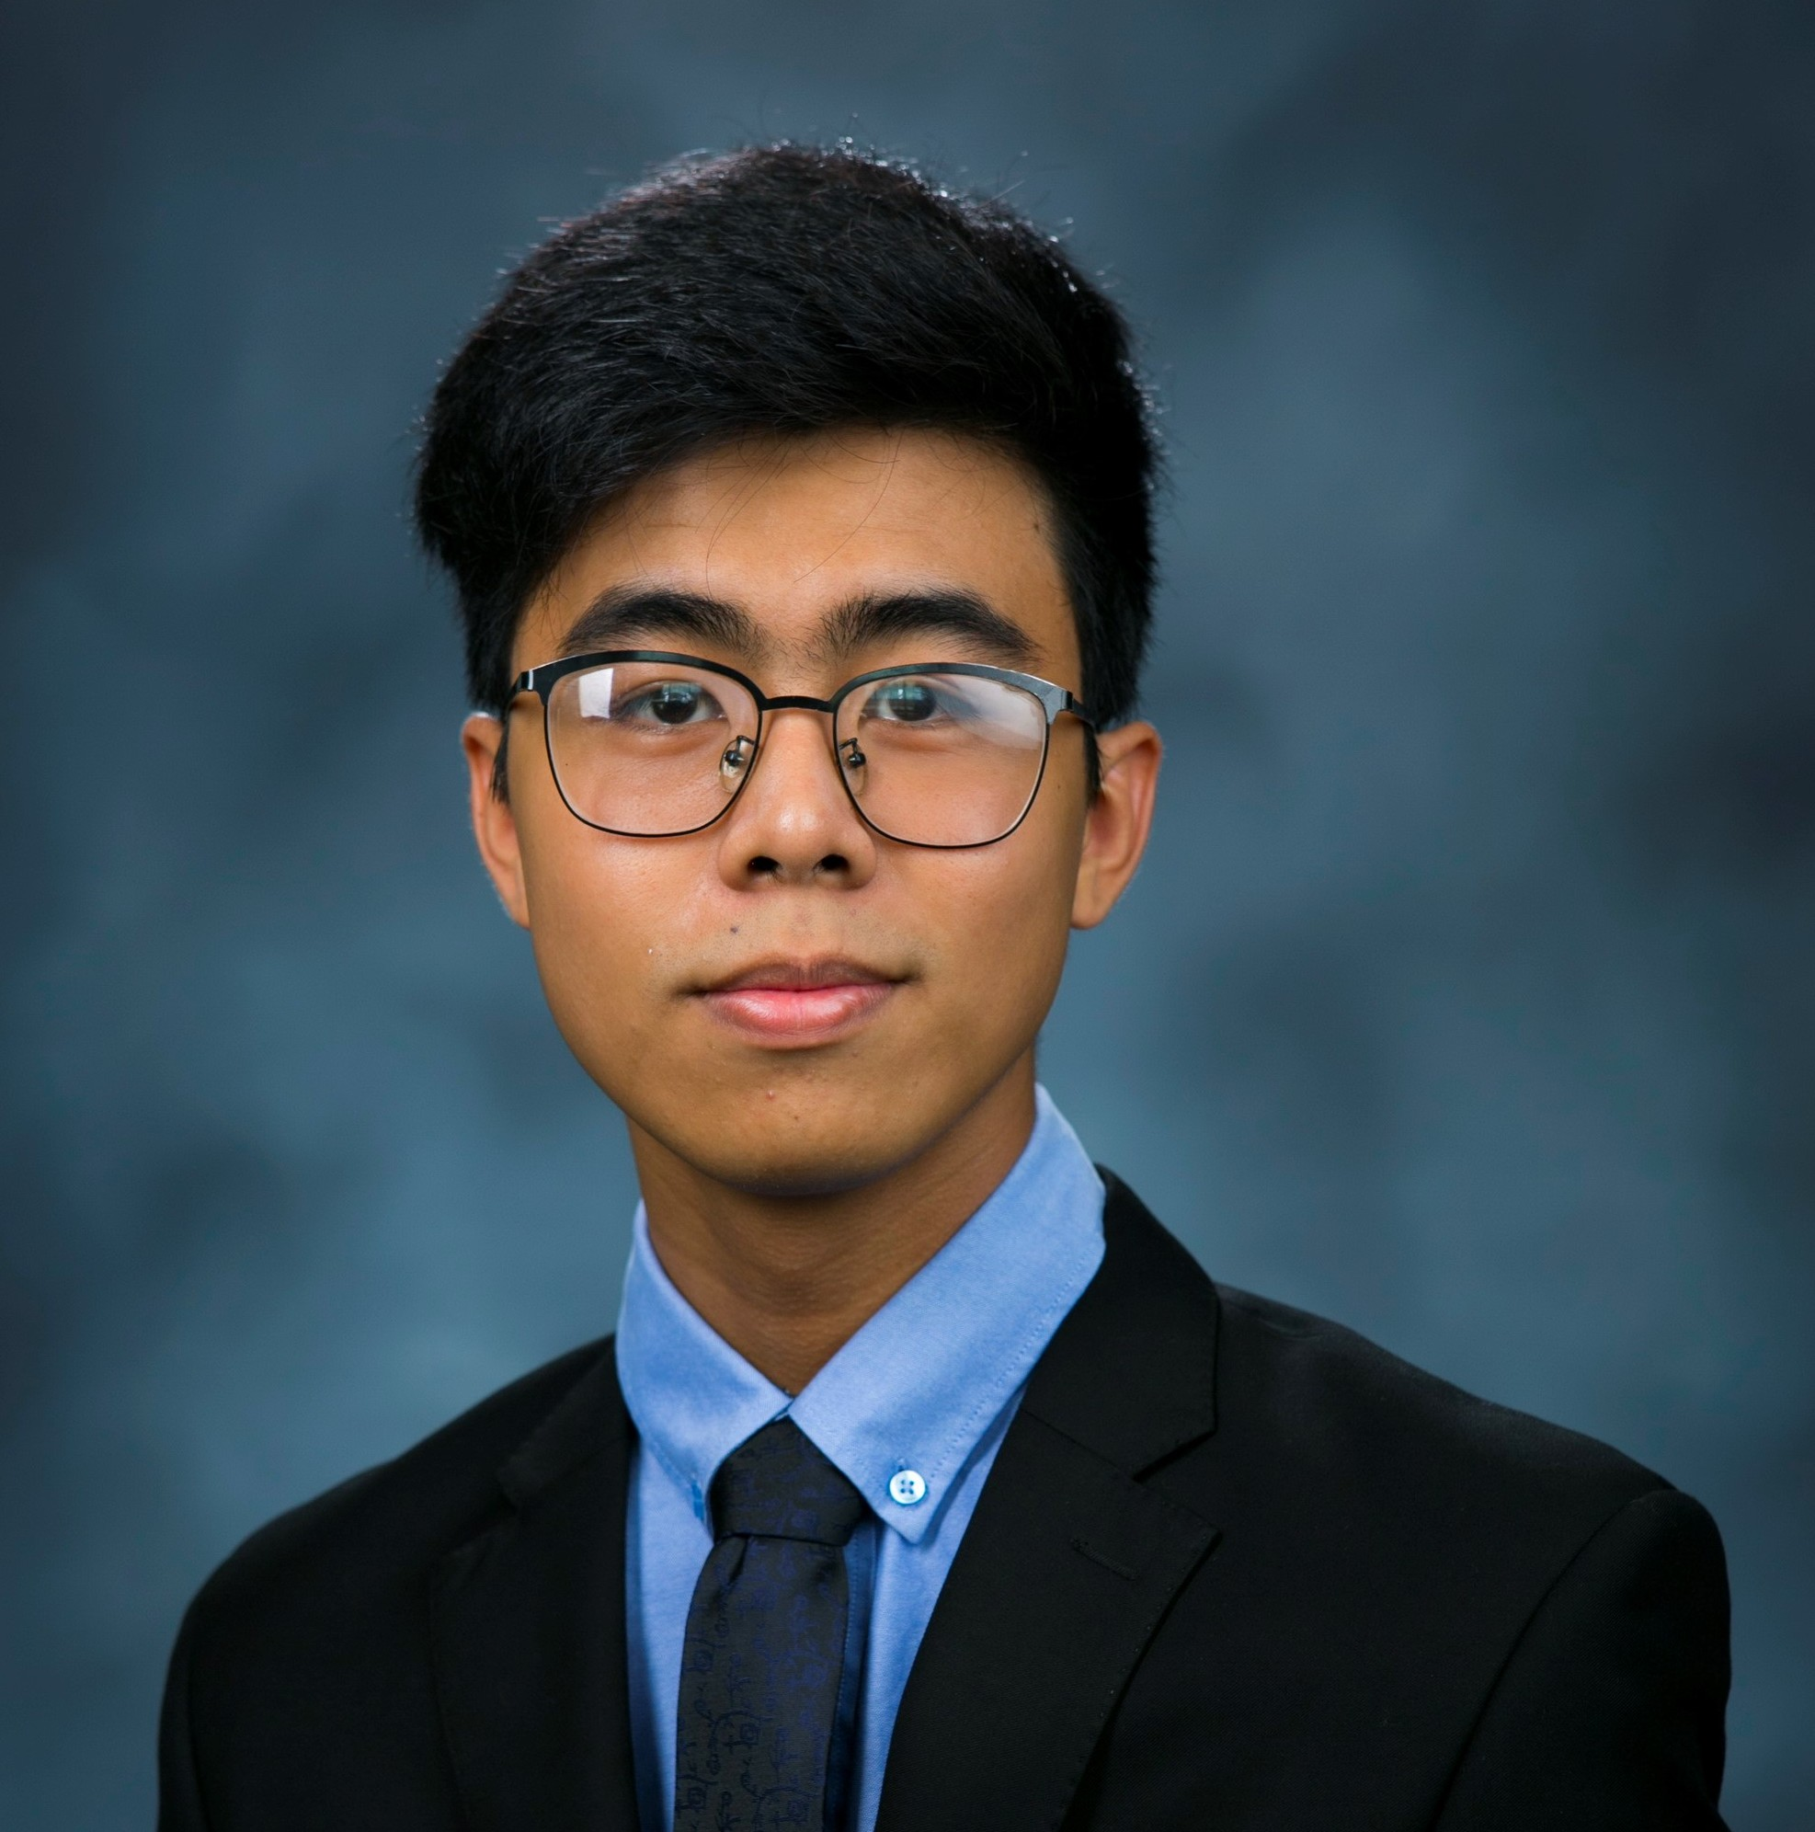
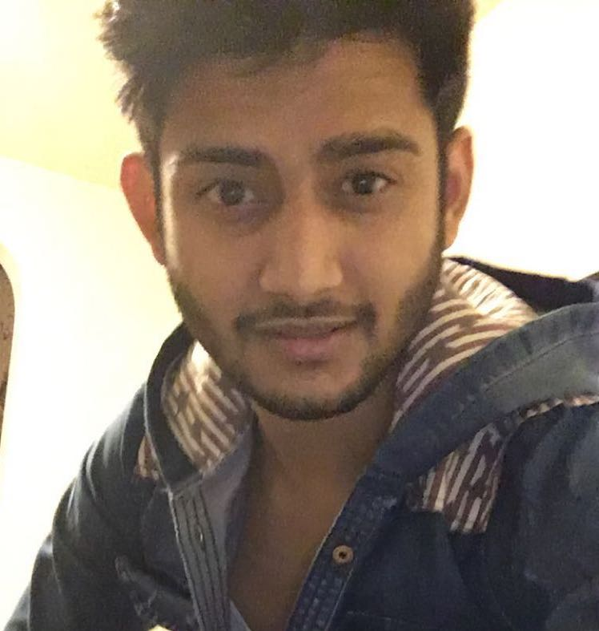
The e-Valuate Team
Jordyn Dent
Project Lead
Kenny Houston
Backend Lead
Megan Phan
Frontend Lead
Jackie Ye
Database Lead
Hau Ha
Full Stack Developer
Action Ghimire
Full Stack Developer
Notes:
Jordyn: So once again, my name is Jordyn, and I am the project lead for the e-Valuate team. (They then introduce themselves). Let me just say, it has been quite the experience working with these incredible individuals all year, and I am super excited to showcase what we have created.

Slide 3
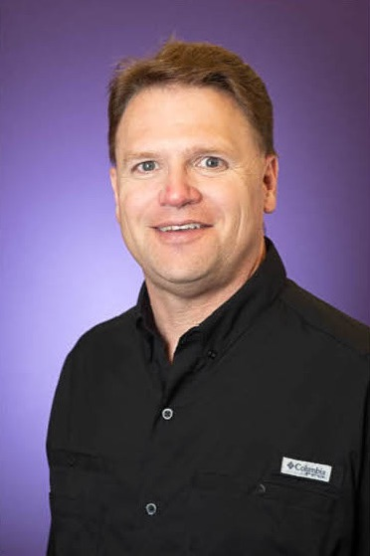
Our Client
Dr. Michael Scherger
Associate Professor for Computer Science at TCU
Poster Chair for the Consortium for Computer Sciences in Colleges: South Central Region (CCSC: SC)
Notes:
Jordyn: Now let me introduce the last member of our team: our client, who you may know as Dr. Michael Scherger. He serves as an associate professor for computer science here at TCU and the newly established Zoom Online University that we are currently enrolled in. He also serves as the poster chair for the Consortium for Computer Sciences in Colleges, specifically the South Central Region. This organization is a small regional conference that focuses on computer science education. It is divided into nine regions, and the south central region is comprised of Texas, Oklahoma, and Louisiana.
Transition: This is significant because it serves as the inspiration for our project, which I will now tell you all about!

Slide 4
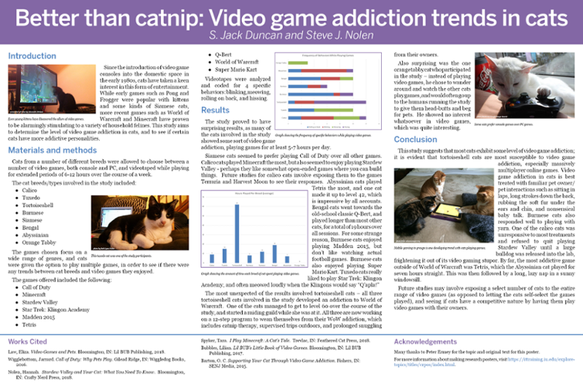
Background and Inspiration
CCSC: SC poster session
Current operation poses issues as everything runs through the poster chair
Notes:
Jordyn: So at the CCSC, which is what we will call it for the remainder of this presentation, exists what is called a poster session. Much like our own student research symposium, or SRS, that usually takes place around this time of the year, the CCSC poster session serves as an opportunity for researchers to showcase their research to other conference attendees in the form of a poster. These posters can cover any computer-related research topic, much like the poster on the right on video game addiction trends in cats.
Since our client has served as the poster chair for this event, he has been directly involved in planning and running the event for the past few years. Since no online or mobile system is in place, this is a fairly stressful task, as our client and anyone he appoints has to run this completely using pen and paper. You can imagine how long this process could take if you have a large amount of poster submissions.
Transition: Because of these pains involved with running the event, our client came to us to help him develop a system that can be utilized for running this event in the future, and I will now pass it on to Kenny to tell you all about what we came up with.

Slide 5
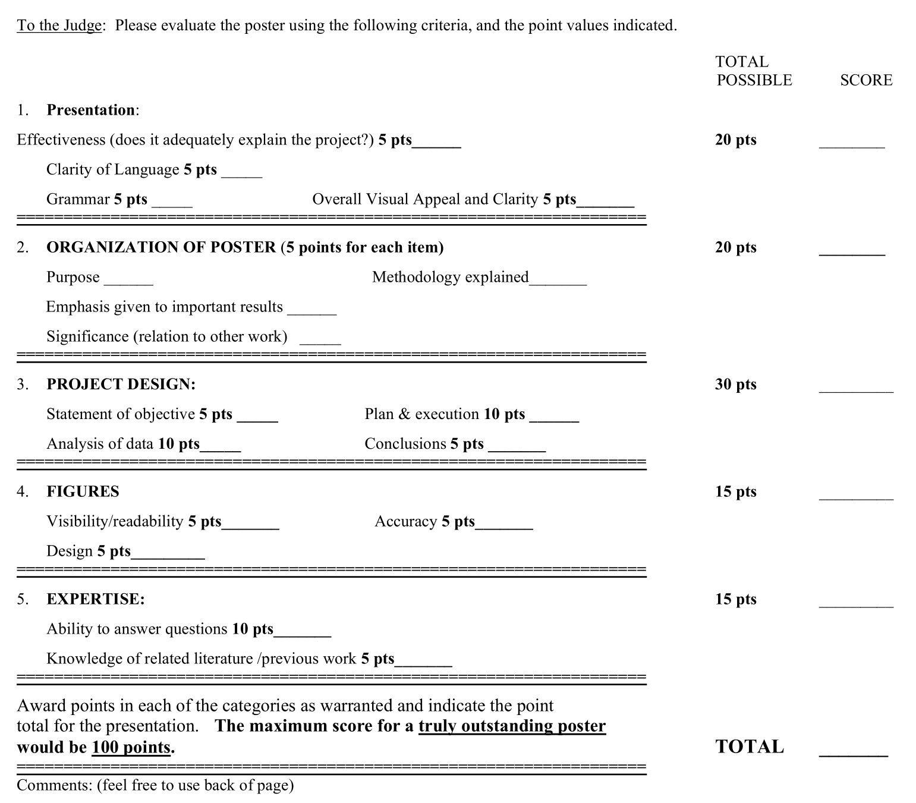
Moving Away from Paper
Interactive rubrics with levels of categories
Electronic entry submissions
Event management
Mobile friendly web app
Notes:
KENNY
EMPHASIZE!!!!!!! the pains of doing this on paper
Better define what we are talking about - entries, posters, etc

Slide 6
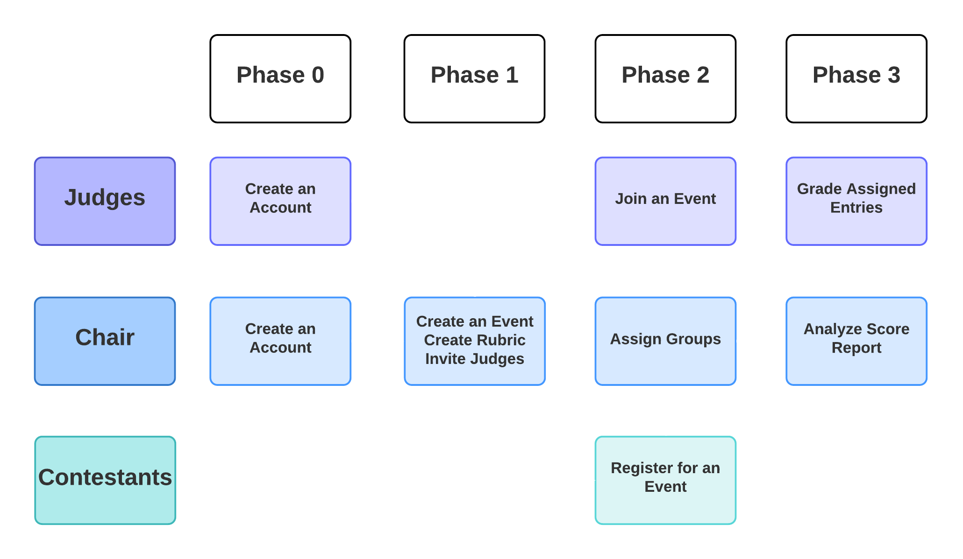
Phase Map
Notes:
KENNY

Slide 7




Tools and Technologies
Notes:
Megan: We decided to choose this tech stack because after doing a lot of research and discussions, these are the ones that we’re mostly comfortable to work with.
Spring boot was new to all of us but it’s pretty straight forward to develop since we all know Java well.
React, on the other hand, takes a lot of time to understand and debug but learning JavaScript is really cool and helpful for our future projects.
MySQL works very well with Spring Boot.
And for hosting the web application, we choose AWS because the free tier option allows us to host the web and db servers for free.
These are popular tools and frameworks, so there are a lot of resources for us to use and maintain our project efficiently.

Slide 8
Phase 0: Create an Account
Notes:
This is the very first step you need to do to be able to use the application. Either you are a chair or a judge, you need to have an account to do other things. Except if you are a contestant, you don’t need an account to be able to register for an event.

Slide 9
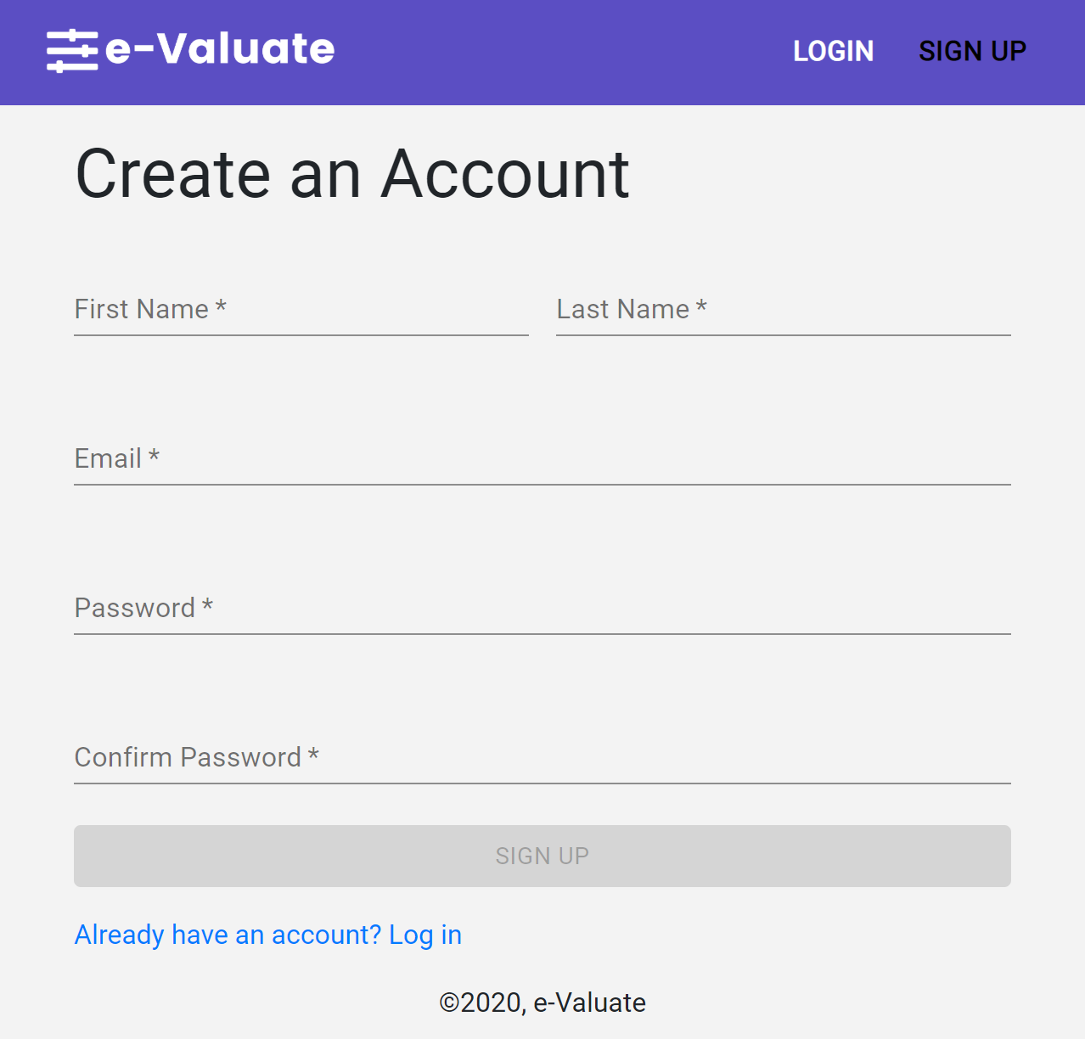
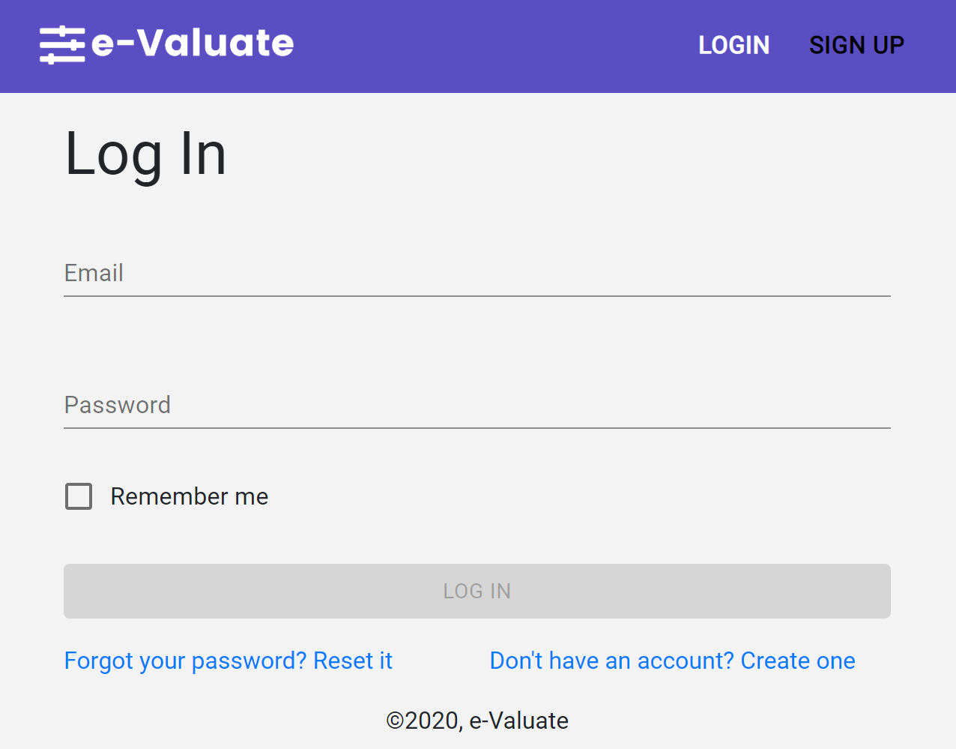
Phase 0 Screenshots
Notes:
Megan: When you go to the website, from the landing page, you can see the buttons to sign up or log in. After filling all the information needed, you can log in using the credentials you created. If you forget your password, you also have the ability to reset them. Once you’ve logged in, it will lead you to a dashboard page. From there, you have the options of creating an event or joining other people’s events.

Slide 10
Phase 1: Create an Event
Notes:
Action: After chair creates an account he will move on to phase 1, where chair creates an event, creates a rubric and invites the judges.

Slide 11
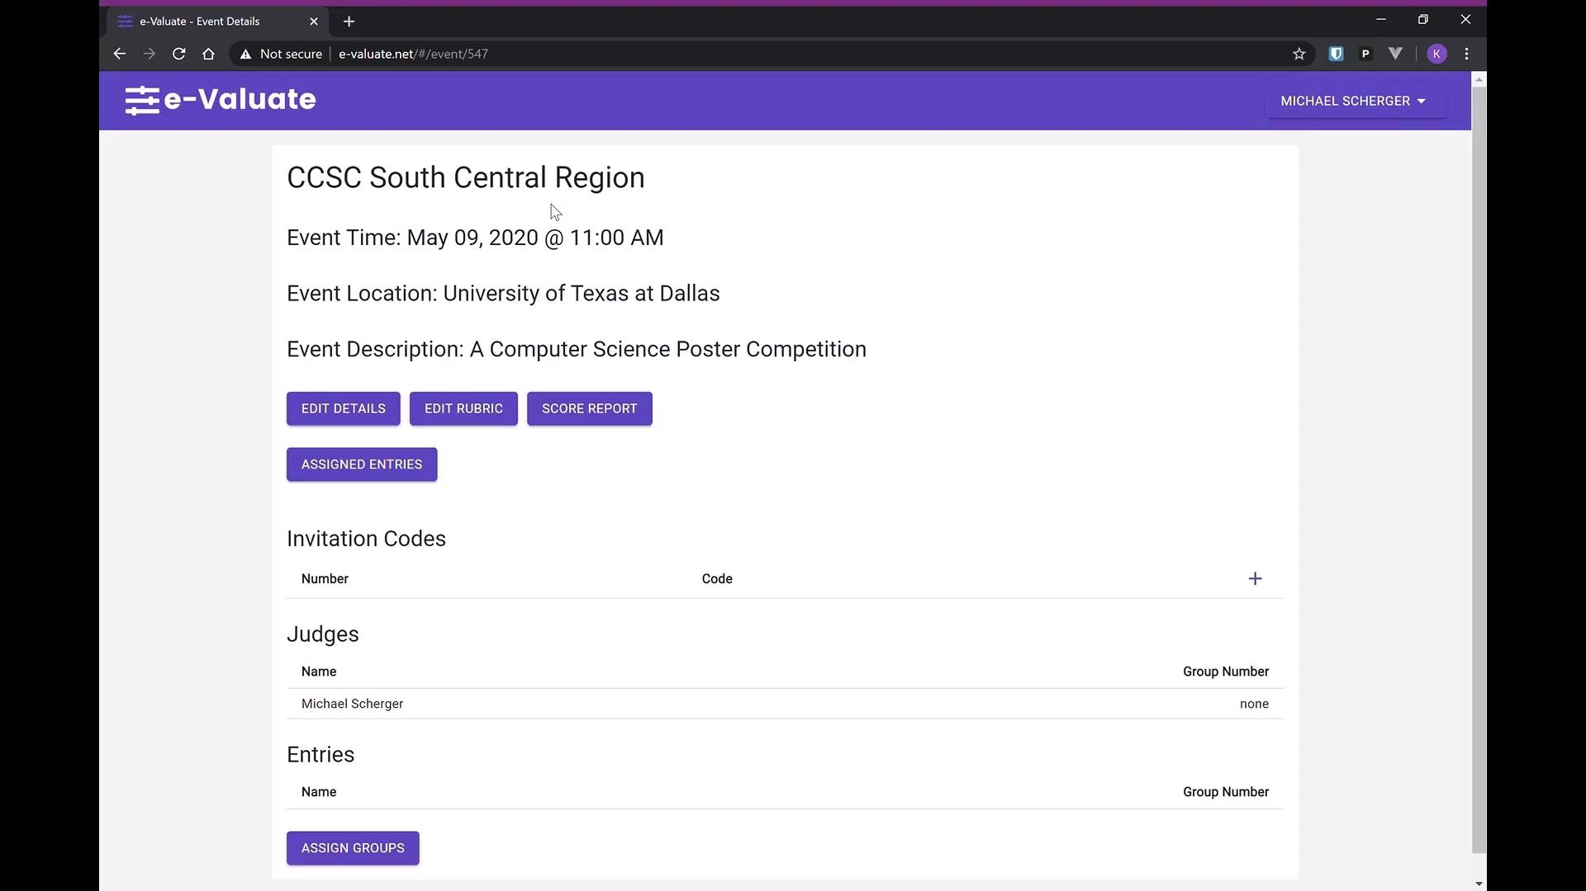
Phase 1 Demo
Notes:
Action

Slide 12
Phase 2: Preparing an Event
Notes:
JACKIE

Slide 13
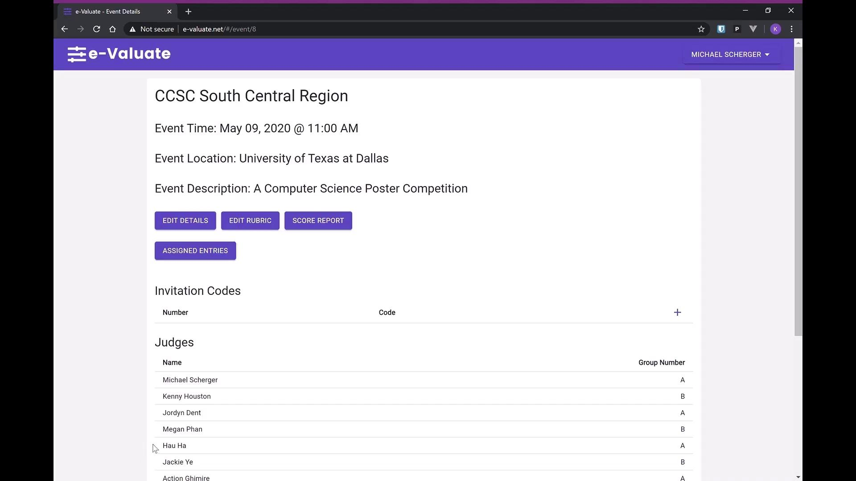
Phase 2 Demo
Notes:
JACKIE
Join an event as a judge: there are 2 things you need first: an account and an invitation code from the chair. Log into the dashboard…
Register an event as a contestant: launch the event details page for anonymous, then click ‘Register button’, type in required information.
Assign judges and entries: assigngroups page, 1 group by default, you can change the number of groups, assign judges and entries to different groups.
So that judges will not be grading all the same entries.

Slide 14
Phase 3: Run an Event
Notes:
HAU

Slide 15
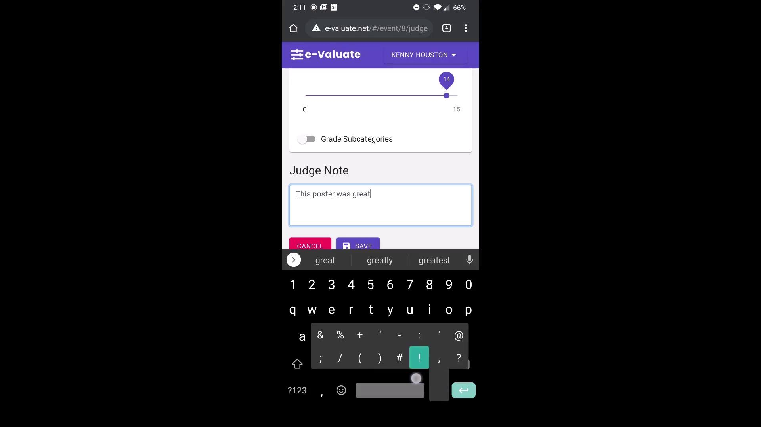
Phase 3 Demo
Notes:
HAU

Slide 16

What We Learned
New developer tools and frameworks
GitHub and version control
Code reviews and testing
Teamwork makes the dream work
Notes:
After this amazing year-long project, we have learned and practiced some new tools and frameworks that we’ve never used before. We also learned some tips for GitHub that I think will be very useful for our jobs after graduation.
It’s a wonderful platform to review each other’s codes and do testing.
When we did some reviews and debugging, we got to make sure that the codes are as polished as it could be.
That makes our project better. And last but not least, teamwork makes the dream work. We’ve learned how to work together efficiently. Especially during this pandemic, communication and team support are very essential.

Slide 17




Challenges
Notes:
Jordyn: Thanks Megan, so with every project, especially group project, comes challenges that we must navigate together in order to reach our goal. Sometimes these challenges are personal things, sometimes they’re team-related things, and sometimes they’re project-content-related things, but they’re all learning opportunities for everyone involved. These are a few that we had to navigate, with tidbits on what we did to combat them or what we would do differently if we were to redo this entire project.
First, life is simply unpredictable. Whether it’s mental health, family issues, piles of schoolwork, or even a global pandemic, it’s sometimes tough to know where your life will be even 24 hours from now. To combat this, we organized tasks appropriately, but looking back, we could have always organized tasks better and done more earlier so we would have less development spikes around deadlines.
The next challenge was utilizing uncooperative or unfriendly development tools. I use these words not to describe the tools themselves, but how they interact with each other. Spring is a fantastic java-based backend application tool and react is a powerful frontend javascript library, but they don’t always talk to each other very easily. This caused problems when building the application for production as well as deployment, as very specific configurations were often needed to properly integrate the tools. This is why, if you noticed, the site showed as “not secure” in the URL bar of the demo videos. When the videos were recorded, the encryption configurations were still being put together for our app, but it’s all secured now. If we were to redo this project, we would try to stick to a stack that utilizes tools that work better with each other.
Next, documentation is very time-consuming. Like for development, we often did a lot of our documentation around deadlines, which kinda defeats the purpose of using documentation as a development tool. If we were to redo this project, we would better keep up with documentation and do it as we go, as there are tens to potentially hundreds of pages of documentation that are required for this project.
Lastly, like Meghan previously mentioned, this semester was...different than others because of the COVID-19 global pandemic. As we prepared to come back to campus after spring break, we were hit with the news that we would not in fact be coming back, and that the remainder of the semester would be online. This meant no more physical meetings, team gatherings, in-person instruction, or real classroom time that we could utilize to complete our work. This sudden shift to complete and total independence is not an easy transition for everyone, as everything we were previously used to changed in an instant. Maintaining accountability amongst ourselves and our team members became more important than ever, and I am so proud of how our team worked together to complete this project during this strange time.
Transition: Now onto the last steps...

Slide 18
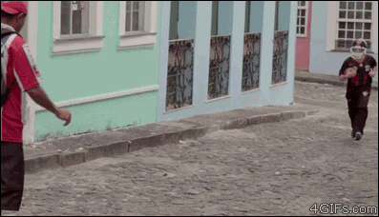
Wrapping Up
Finish documentation
Hand-off to Dr. Scherger
Use e-Valuate for future CCSC poster sessions
Notes:
Jordyn: ...what’s up next is finishing up the documentation now that we are completely done with development and testing. Once that is all said and done, we will officially hand the completed project off to Dr. Scherger and ride off into the sunset! While we couldn’t see our application in action this year because of the pandemic, for the distant future, we hope to see this project utilized by the CCSC to manage their poster session, and maybe even see it be utilized by TCU for the SRS or any other contest.
Transition: Now, one last word of thanks for everyone involved with this project.

Slide 19
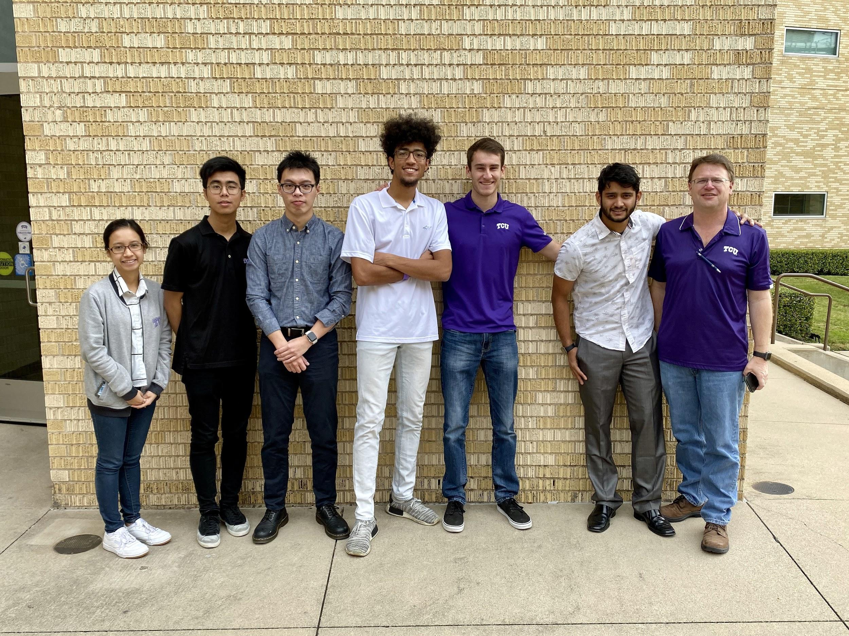
Thank You!
Notes:
Jordyn: We want to give a BIG thank you to our client and instructor, Dr. Scherger. Without your guidance, this project would not have been possible, and I know that the CCSC will be very thankful for your contributions. We would also like to thank Dr. Wei for additional guidance in software engineering and helping choose the best technologies for our project. Lastly, one big thank you to all of you involved with TCU Computer Science: faculty, staff, and students. Our time here, while nearly up, will be remembered forever, and has immensely prepared us for our future careers. Thank you.
I hope you all enjoyed our presentation, and we will now take questions.

